Slide 1
AI Idea - XL CB
February 2026
Authors: Blaise DiMartino & Alex Grinberg

Slide 2
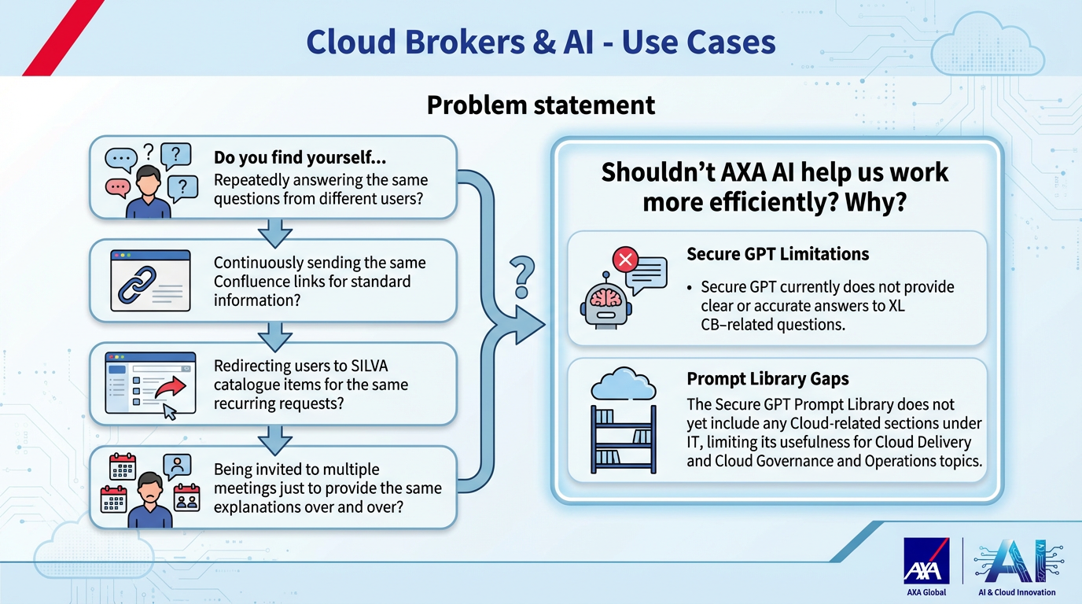

Slide 3
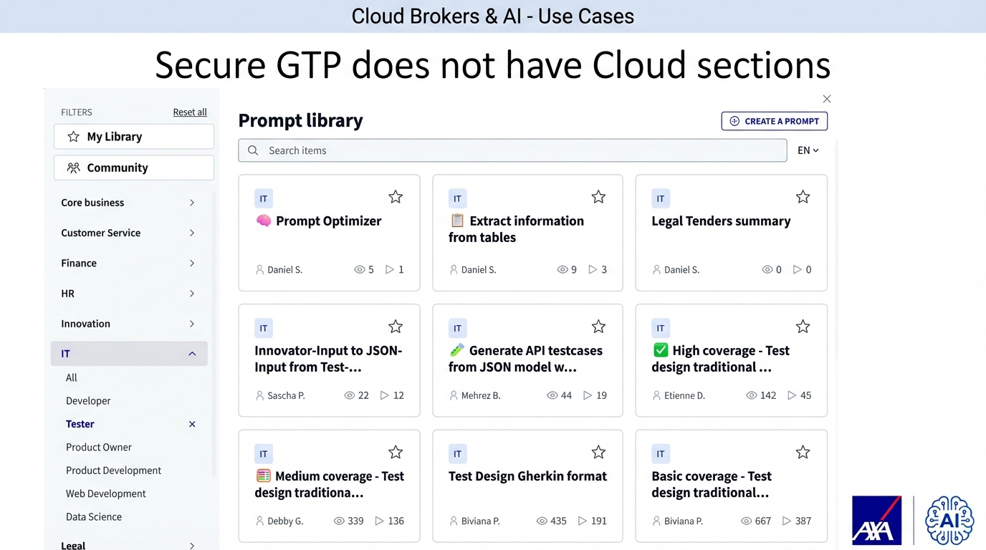

Slide 4
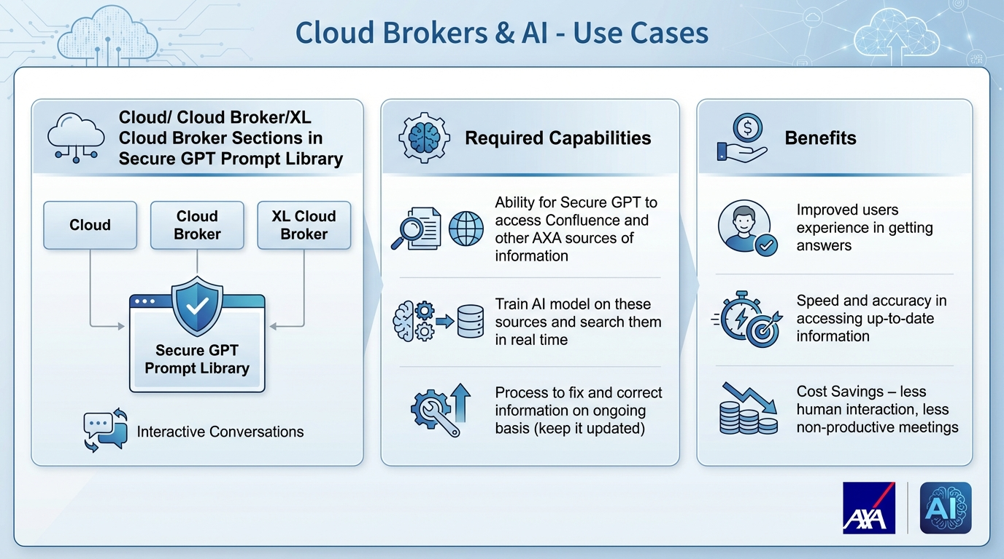

Slide 5
